Slide 1


Study of Twitter Sentiment Analysis
Using Machine Learning Algorithms on Python
Study of Twitter Sentiment Analysis Using Machine Learning Algorithms on Python
This presentation provides an overview of the advancements in Twitter sentiment analysis, discussing methodologies, machine learning models, and Python-based implementations designed to address these challenges.
Under the guidance of
Mr. I. Narasimha Rao M. Tech Assistant Professor
G. PALLAVI - 216C1A6615
B. RAGA - 216C1A6605
K. ANUSHA - 216C1A6619
K. LAXMI THULASI - 216C1A6621

Slide 2

ABSTRACT
Twitter has become a widely utilized platform for individuals to express their opinions and emotions on various topics and events.
Sentiment analysis is used to analyze data and extract the emotions or sentiments conveyed.
Twitter sentiment analysis applies this methodology specifically to
Twitter data(tweets) to identify users’ sentiments.
However, tweets’ unique characteristics, such as their limited character count and frequent use of slang, abbreviations, and emojis, pose significant challenges for processing and analysis.
The goal is establishing a framework for effectively analyzing Twitter data and id.
Study of Twitter Sentiment Analysis Using Machine Learning Algorithms on Python

Slide 3


INTRODUCTION
Twitter sentiment analysis has become a pivotal area of study, leveraging the platform's extensive and diverse user base that generates real-time data on various topics
Sentiment analysis, or opinion mining, identifies and classifies text sentiments as positive, negative, or neutral. Applied to Twitter, it provides insights into public perceptions, trends, and opinions on topics like products, events, and societal issues.
Study of Twitter Sentiment Analysis Using Machine Learning Algorithms on Python
The informal and dynamic nature of tweets characterized by slang, abbreviations, emojis, hashtags, and links introduces unique challenges, necessitating robust preprocessing and advanced natural language processing (NLP) techniques.
This study explores the application of machine learning algorithms in Python to perform sentiment analysis on Twitter data, addressing these challenges to extract actionable insights from this unstructured data source.

Slide 4




Existing System
Start
The existing systems often rely on traditional approaches, such as keyword-based or rule-based sentiment analysis, which focus on identifying specific words or patterns in text.
These methods are sometimes combined with basic machine learning algorithms like Naïve Bayes, Random Forest, SVM, etc for classification.
Data Collection
Study of Twitter Sentiment Analysis Using Machine Learning Algorithms on Python
Preprocessing
Process Include:
Feature Extraction
Data Collection: Using Twitter API to scrape tweets in real-time or precompiled datasets
Preprocessing: Removing noise, tokenization, and stemming.
Model Training
Model Training: The prepared dataset is split into training, validation, and test sets. Then Outputs include trained models and performance metrics.
Feature Extraction: Converting text into numerical data for machine learning.
End

Slide 5

Advantages Of
Traditional Approaches
Simple algorithms like SVM and Naïve Bayes ensure ease of implementation.
1
2
Analyze data across diverse domains such as customer feedback and trends.
3
Facilitates data collection with tools like the Twitter API.

Slide 6

Existing System Challenges
The existing system faces multiple challenges in processing modern social media language. It struggles to keep up with the dynamic and diverse nature of online communication, leading to limited performance in key areas.
Study of Twitter Sentiment Analysis Using Machine Learning Algorithms on Python
1
Limited accuracy in understanding abbreviations, slang, and emojis.
2
Inefficiency in handling short-length and diverse text patterns.
3
Poor scalability for large datasets and real-time analysis.
4
Lack of adaptability to dynamic social media trends.

Slide 7
Applications of Twitter Sentiment Analysis using Traditional Methods
2
Market Research:
1
Brand Monitoring:
Extract insights on user preferences, behavior, and opinions about specific topics or competitors.
Track sentiment changes over time to align marketing strategies.
Analyze tweets to understand public sentiment about a company, product, or service.
Identify trends in customer feedback and detect potential crises.
3
Political Sentiment Analysis:
4
Social Issue Monitoring:
Assess public opinion on political parties, policies, or candidates during elections.
Monitor the impact of political events on public sentiment.
Understand public sentiment on pressing issues such as climate change, health crises, or social movements.
Analyze the impact of advocacy or awareness campaigns.

Slide 8
Proposed System
Data Input (Raw Text)
Processing
(Tokenization, Stemming, Noise Removal.
Feature Extraction
(Text Vectorization, TF-IDF, Word Embeddings)
Real-Time Analysis
(Sentiment Classification, Output)
Algorithm Integration
(Logistic Regression, SVM, Naïve Bayes, Random Forest)
The proposed system leverages advanced machine-learning techniques to improve the performance of sentiment analysis. It addresses challenges like noisy data and short-form text and incorporates powerful libraries for feature extraction and sentiment classification.
Proposed System:
Employs advanced machine learning algorithms: Logistic Regression, SVM, Naive Bayes, and Random Forest.
Study of Twitter Sentiment Analysis Using Machine Learning Algorithms on Python
Robust preprocessing to handle noisy and short-form text, using tokenization and stemming.
Implements Python libraries such as sci-kit-learn, NLTK, and Pandas for feature extraction and sentiment classification.
Advantages:
1
Higher accuracy in sentiment classification.
2
Scalability for large datasets and real-time analysis.
3
Adaptable to evolving language trends.
.

Slide 9

Disadvantages of Proposed System
1
Requires more processing power and time.
2
Relies heavily on external libraries
3
Real-time analysis demands significant infrastructure

Slide 10
Life Cycle of Proposed System
Twitter Data Collection: Collect tweets and hashtags from Twitter for analysis.
Data Labeling and Pre-processing: Label and clean the data to ensure it's ready for analysis.
Exploratory Investigation: Analyze patterns and trends in the data to gain insights.
Feature Extraction using TF-IDF: Extract key features using TF-IDF to identify important
words.
Sentiment Prediction using Ensemble Deep Learning Classifier: Use an ensemble deep-learning classifier to improve
sentiment prediction accuracy.
Sentiment Categories: Categorize sentiments into four types: Sad, Anger, Joy,
Fear, and more with emojis for visualization
Data Labelling and
Pre-Processing
Twitter Data
Study of Twitter Sentiment Analysis Using Machine Learning Algorithms on Python
Exploratory Investigation
Feature Extraction
using TF-IDF
Sentiment Prediction using Ensemble Deep Learning Classifier
Positive
Negative
Neutral

Slide 11
Hardware Configurations
Software Specifications
Windows 10/11, macOS, or any modern Linux distribution
Python Version: 3.7 or later
Python Libraries:
tkinter
pandas
matplotlib
seaborn
wordcloud
scikit-learn For text processing using CountVectorizer
nltk
joblib
Text Editor/IDE:
PyCharm
VS Code
Jupyter Notebook (for testing)
IDLE (comes with Python
Processor: Intel core i3 or above.
64-bit, quad-core, 2.5 GHz minimum per core
Ram: 4 GB or more for smoother performance
Hard disk: 10 GB of available space or more.
Display: Dual XGA (1920 x 1080) or higher resolution
monitors
Operating system: Windows, macOS, or Linux
Study of Twitter Sentiment Analysis Using Machine Learning Algorithms on Python

Slide 12
Modules used in the Twitter Sentiment Analysis
Data Upload: A functionality enabling users to upload datasets (e.g., CSV files) containing tweets for sentiment analysis. The uploaded data forms the basis for preprocessing, training, and testing models.
Text Preprocessing: Tools such as re are used to clean and preprocess raw text by removing noise (e.g., URLs, special characters, and stop words) for better analysis.
Feature Extraction:
CountVectorizer: Converts text data into numerical features using a bag-of-words model.
WordCloud: Visualizes frequently used words in the dataset, highlighting common themes.
Machine Learning Models: Pre-trained models (e.g., sentiment classifiers) are employed for analyzing the polarity of tweets (positive, negative, or neutral). Further specifics can be customized.
Visualization Libraries:
Matplotlib and Seaborn: Used to create insightful visualizations of sentiment distributions, trends, and other related metrics.
Natural Language Processing (NLP):
nltk: Assists in tasks such as tokenization and stopword removal, ensuring efficient text processing for sentiment analysis.
Graphical User Interface (GUI):
Tkinter: Provides a user-friendly interface for dataset uploads, model interaction, and visualization displas.
Study of Twitter Sentiment Analysis Using Machine Learning Algorithms on Python

Slide 13
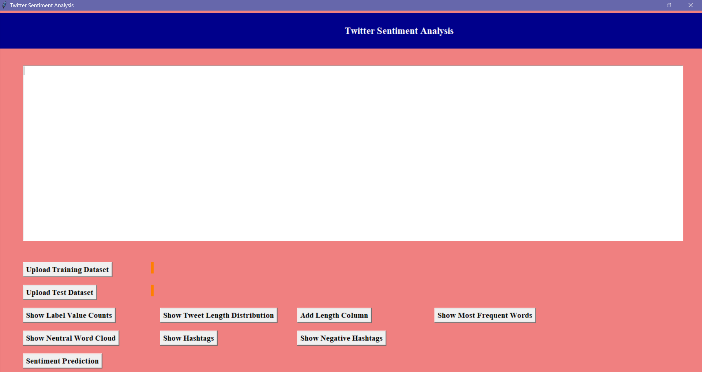
User Interface
Study of Twitter Sentiment Analysis Using Machine Learning Algorithms on Python
Sentiment analysis involves determining the sentiment expressed in tweets, categorizing them as positive, negative, or neutral.
This project aims to provide insights into public opinion on various topics by analyzing the sentiments of tweets.

Slide 14
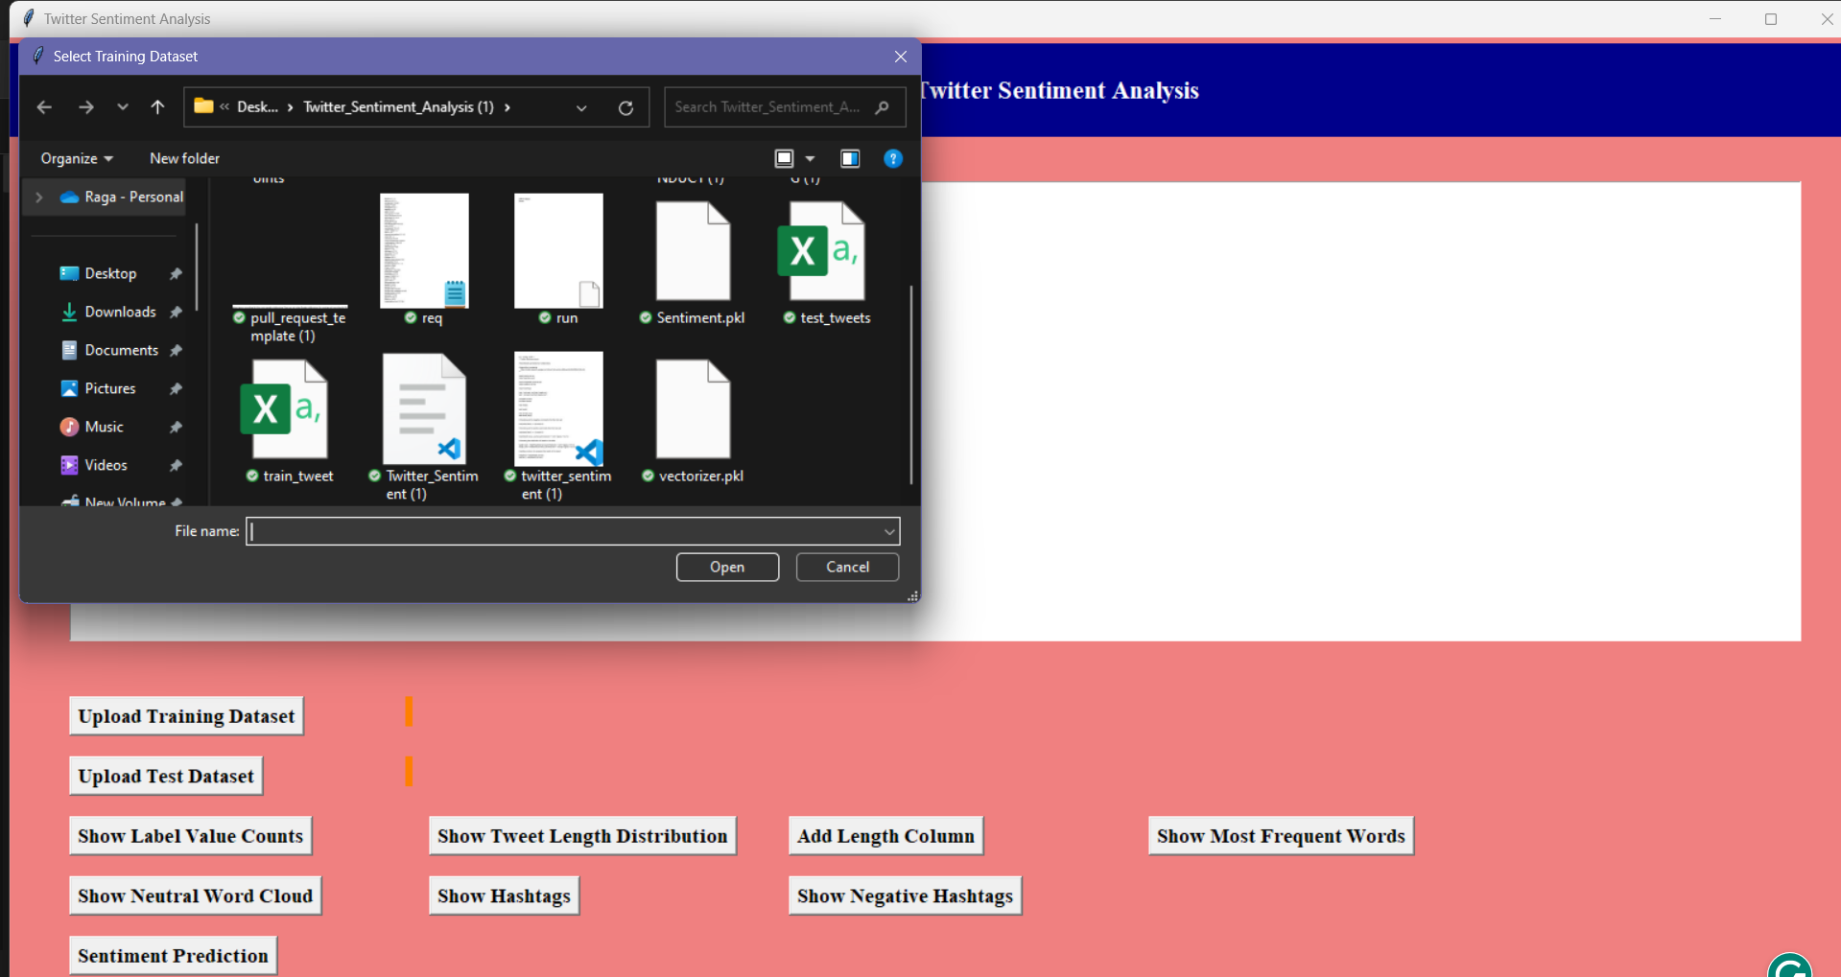
Data Upload and Preprocessing:
Study of Twitter Sentiment Analysis Using Machine Learning Algorithms on Python
These buttons will upload the training and test datasets, and preprocess the data

Slide 15
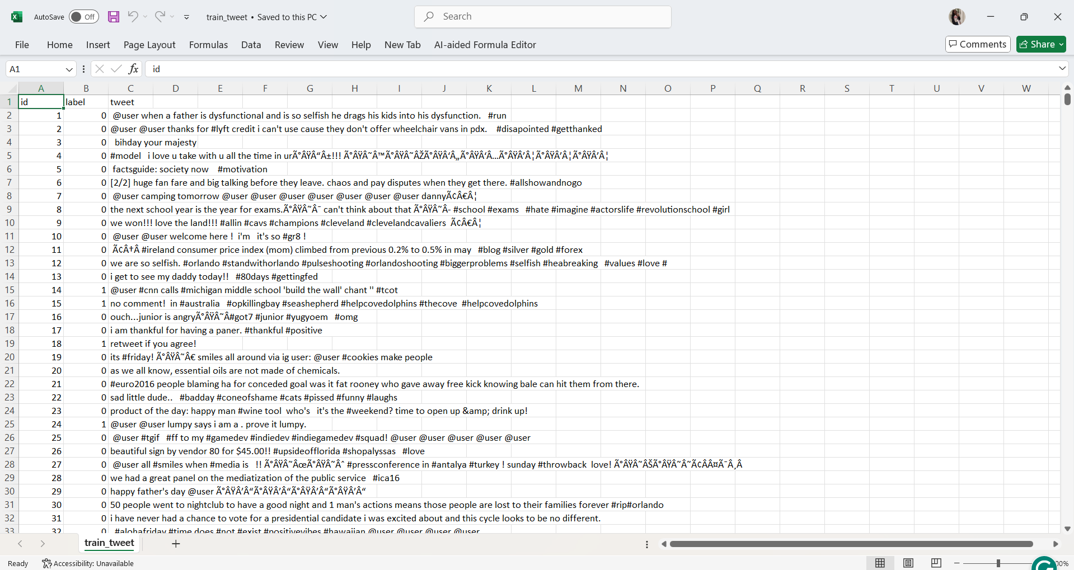
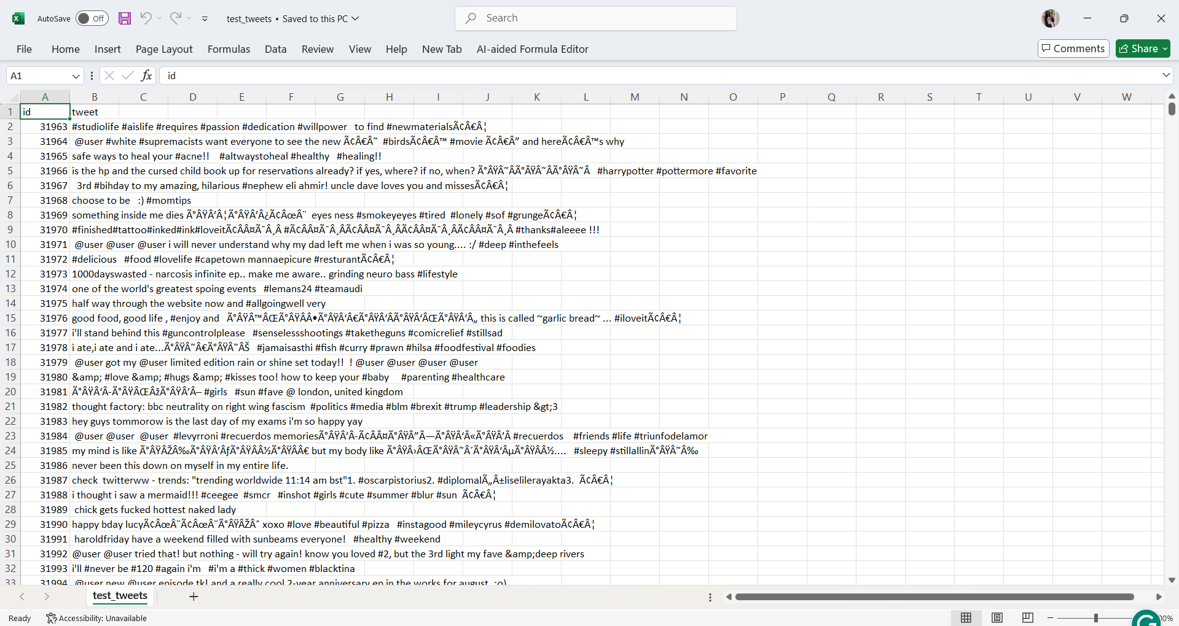
Training and Test Dataset :
Study of Twitter Sentiment Analysis Using Machine Learning Algorithms on Python
Ensures that the data is in a clean and usable format

Slide 16
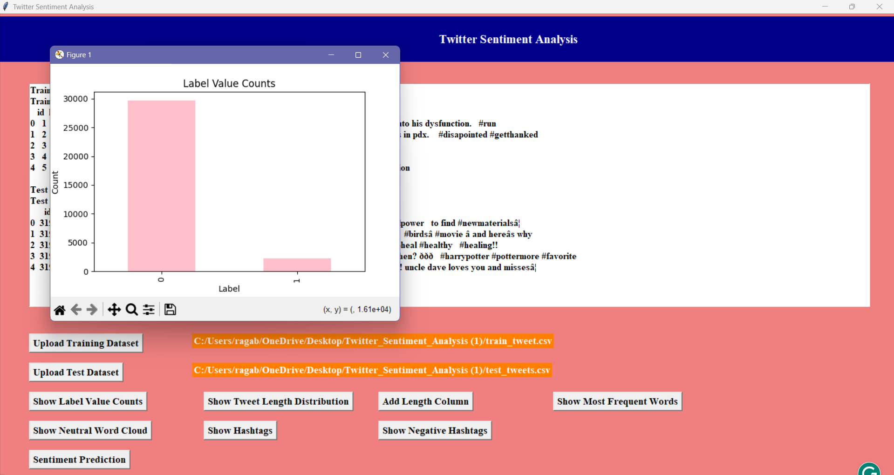
Data Visualization and Analytics :
Study of Twitter Sentiment Analysis Using Machine Learning Algorithms on Python
“SHOW LABEL VALUE COUNTS”, button will displays the distribution of sentiment labels in the dataset.

Slide 17
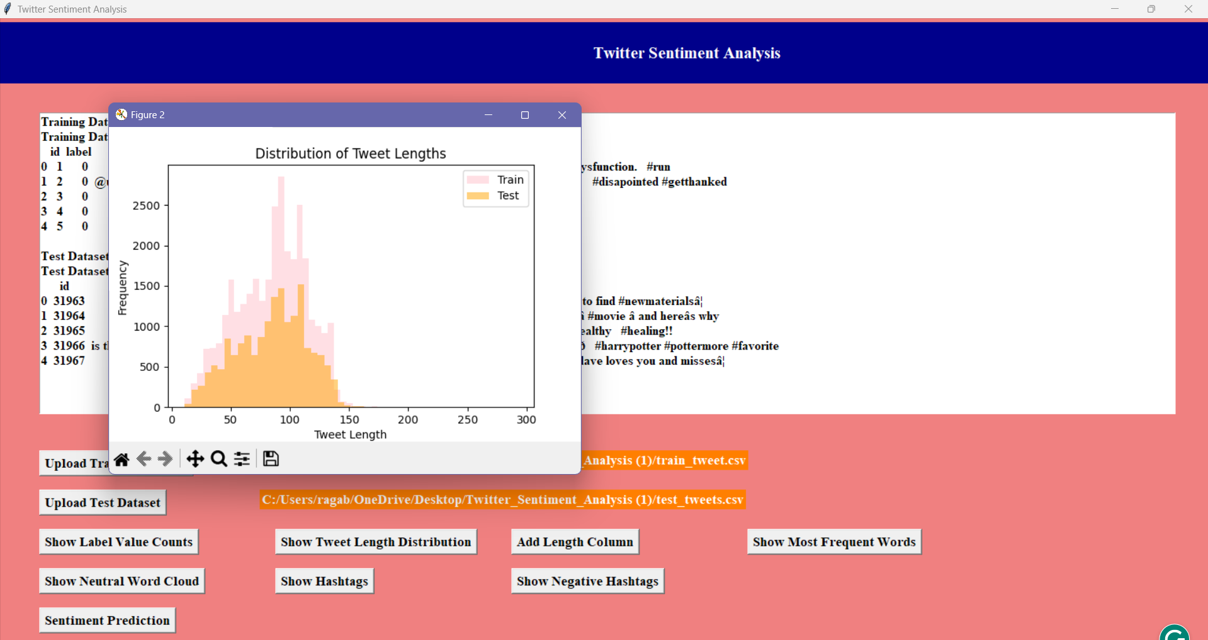
Data Visualization and Analytics :
Study of Twitter Sentiment Analysis Using Machine Learning Algorithms on Python
“SHOW TWEET LENGTH DISTRIBUTION”, button will Visualizes the distribution of tweet lengths based on the given dataset.

Slide 18
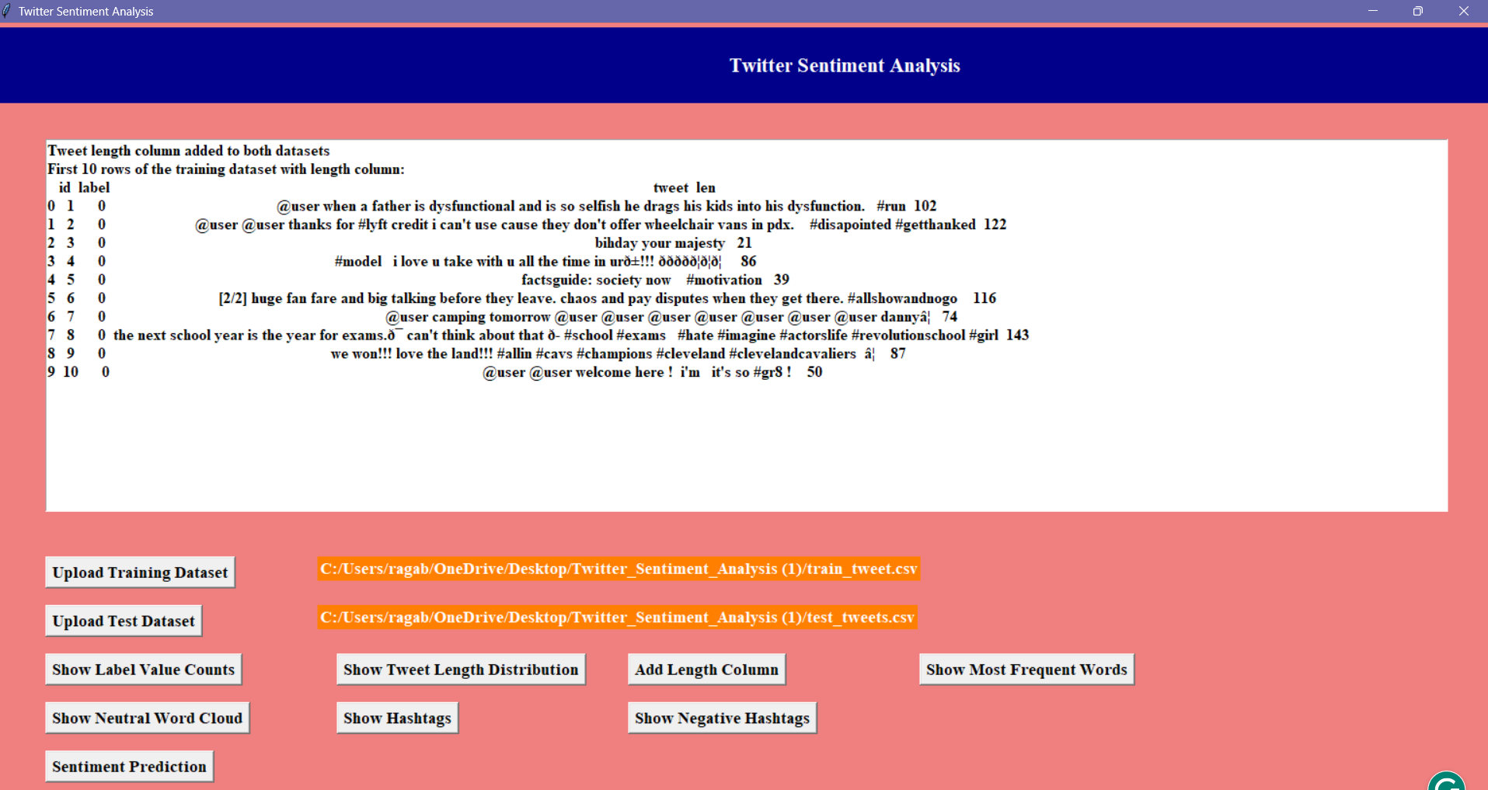
Data Visualization and Analytics :
Study of Twitter Sentiment Analysis Using Machine Learning Algorithms on Python
“ ADD LENGTH COLUMN”, button adds a column to the dataset that shows the length of each tweet.

Slide 19
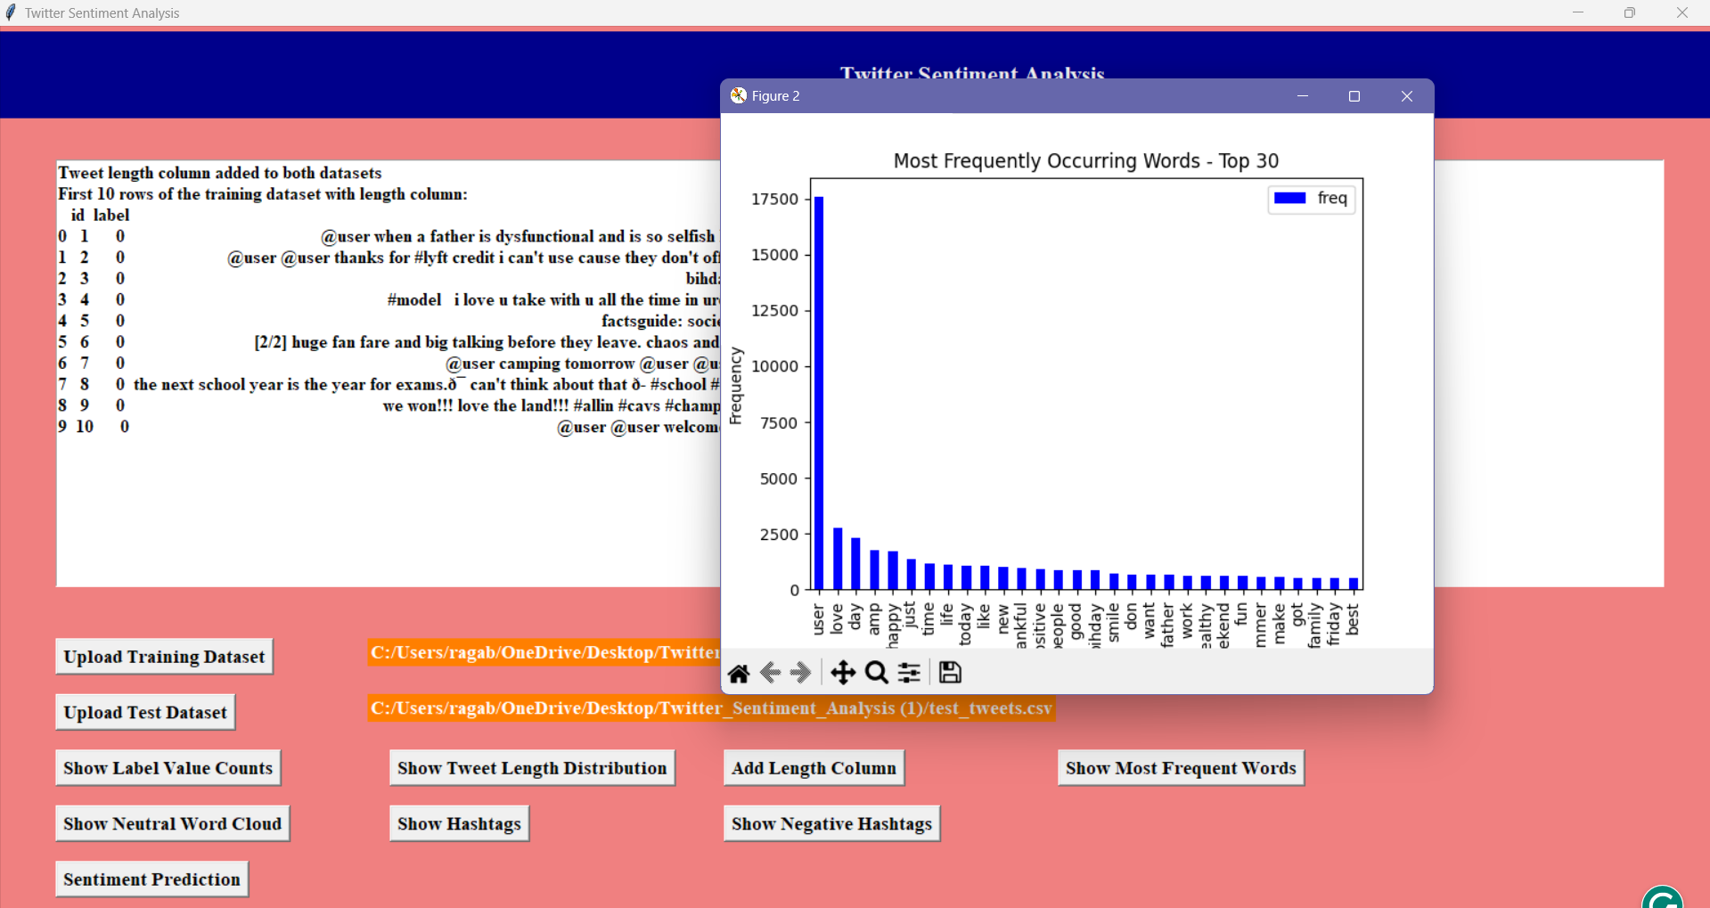
Data Visualization and Analytics :
Study of Twitter Sentiment Analysis Using Machine Learning Algorithms on Python
“SHOW MOST FREQUENT WORDS”, button identifies and visualizes the most commonly occurring words in the dataset.

Slide 20
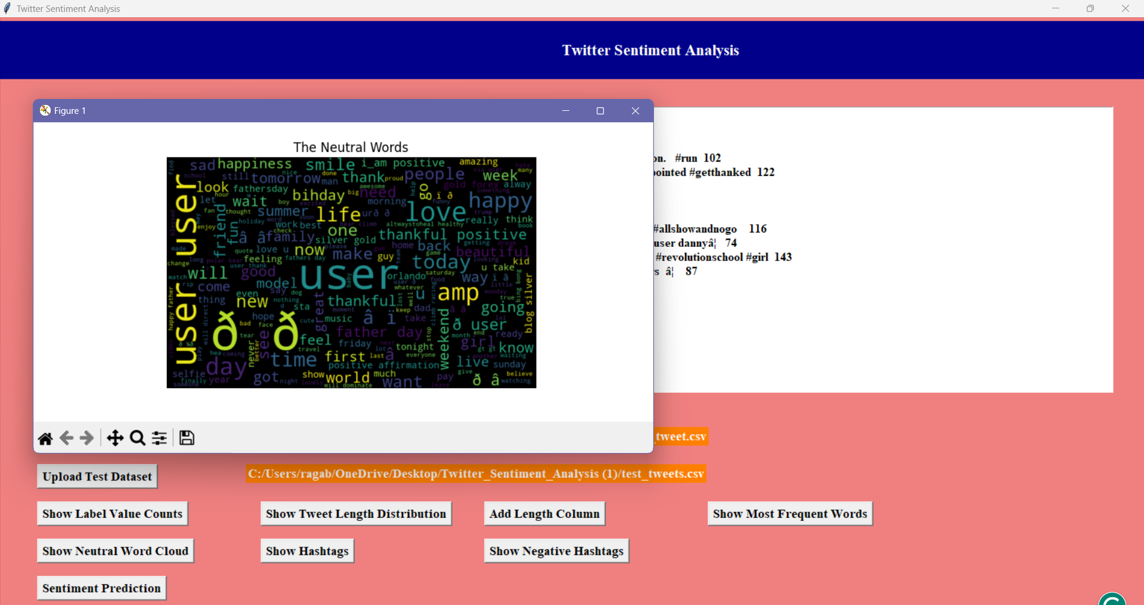
Data Visualization and Analytics :
Study of Twitter Sentiment Analysis Using Machine Learning Algorithms on Python
“SHOW NEUTRAL WORD CLOUD”, button generates a word cloud that visually represents the most frequent words in neutral tweets.

Slide 21
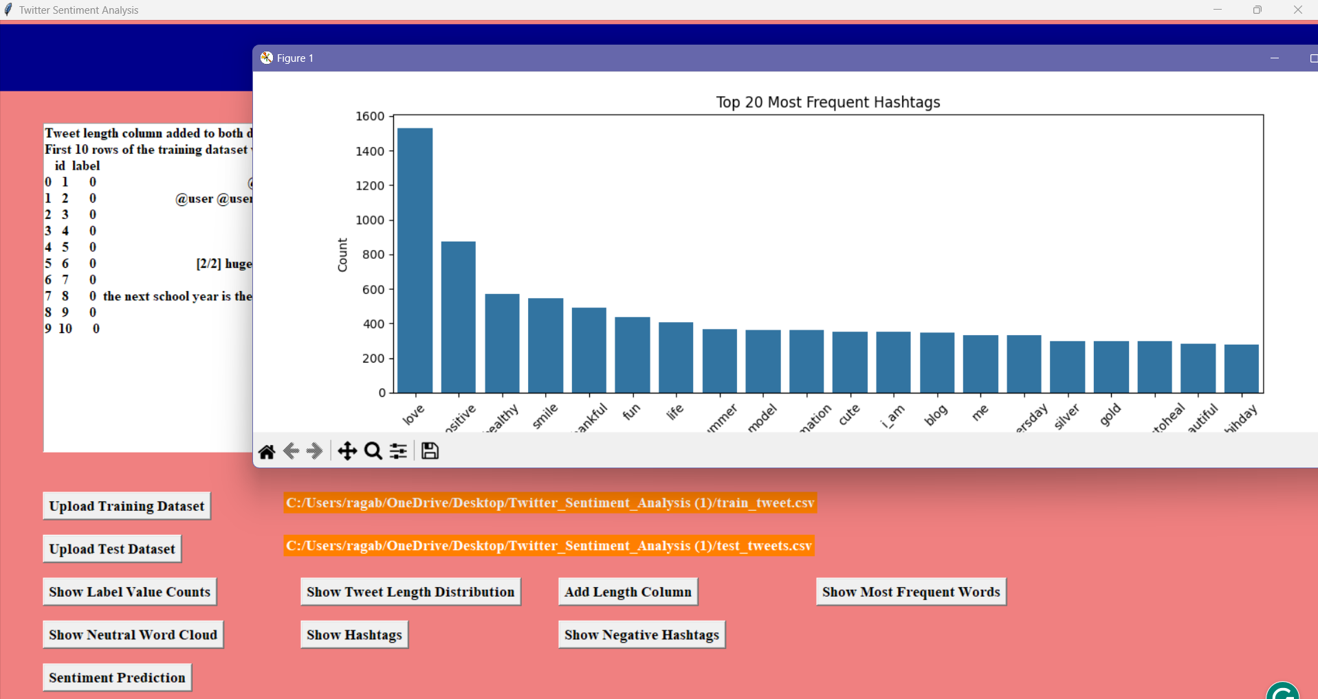
Data Visualization and Analytics :
Study of Twitter Sentiment Analysis Using Machine Learning Algorithms on Python
“SHOW HASHTAGS”, button displays the most frequently used hashtags in the tweets.

Slide 22
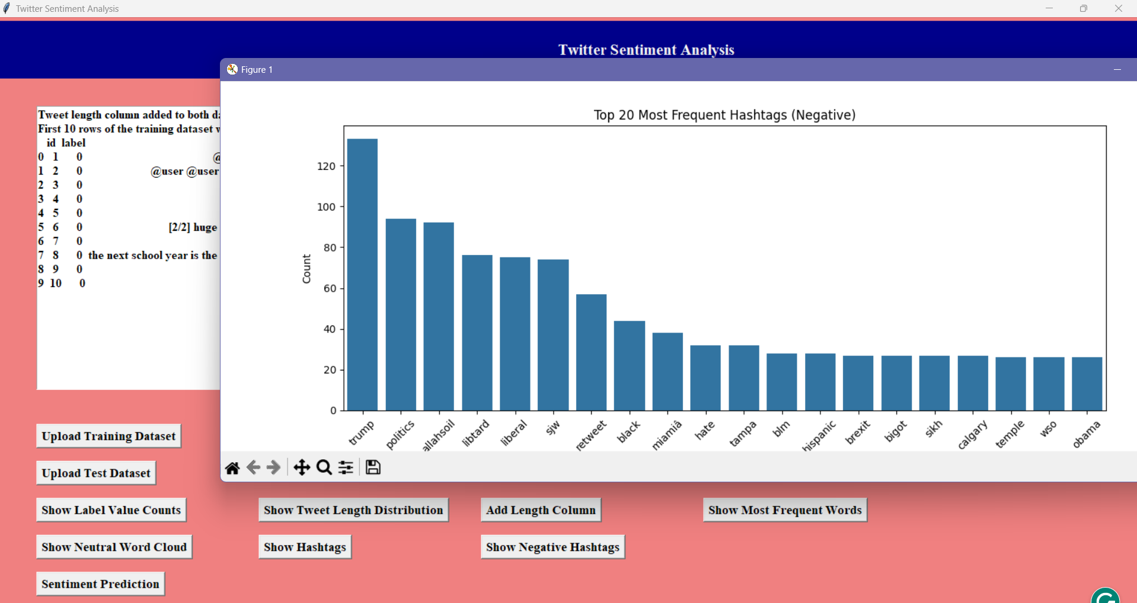
Data Visualization and Analytics :
Study of Twitter Sentiment Analysis Using Machine Learning Algorithms on Python
“SHOW NEGATIVE HASHTAGS”, button highlights the hashtags that are most frequently associated
with negative sentiments in the tweets.

Slide 23
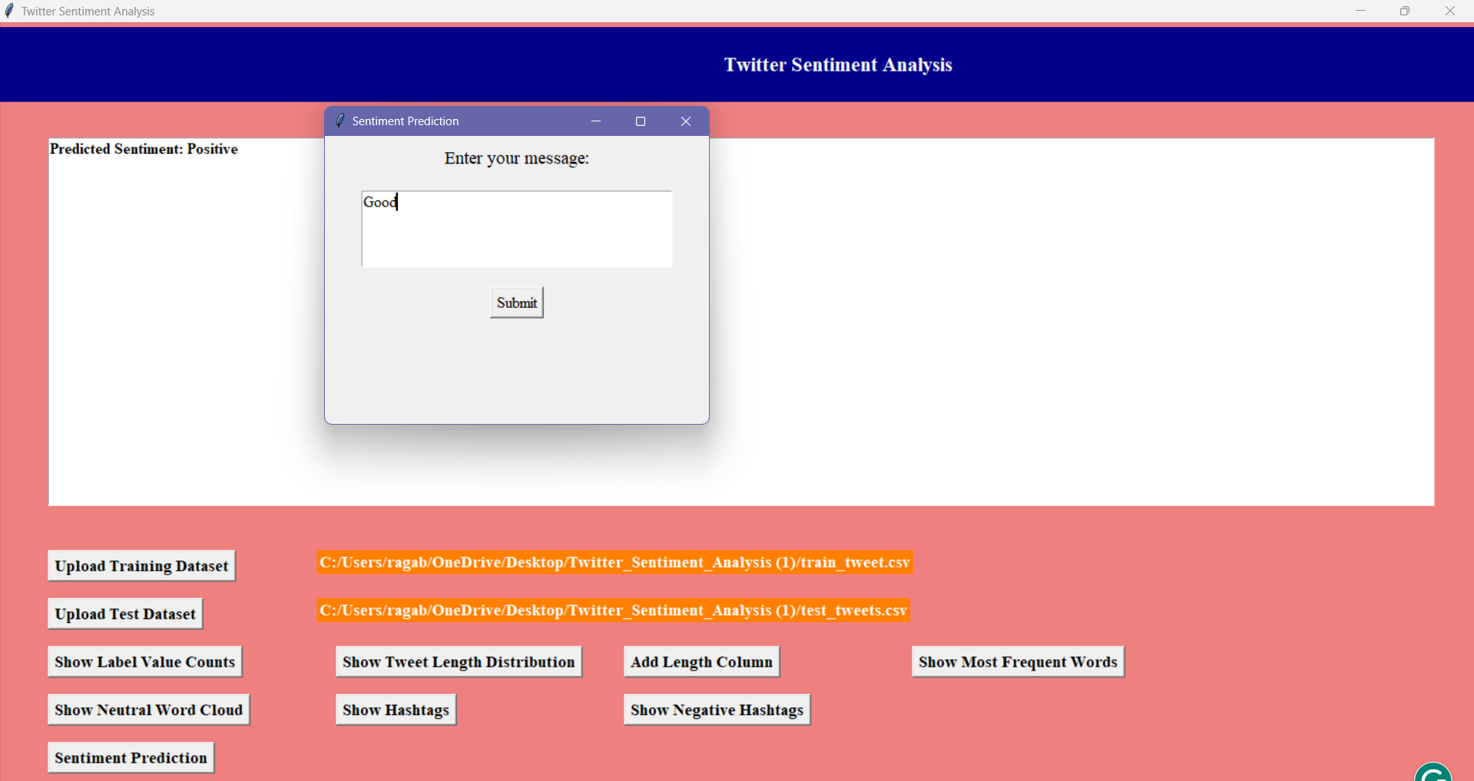
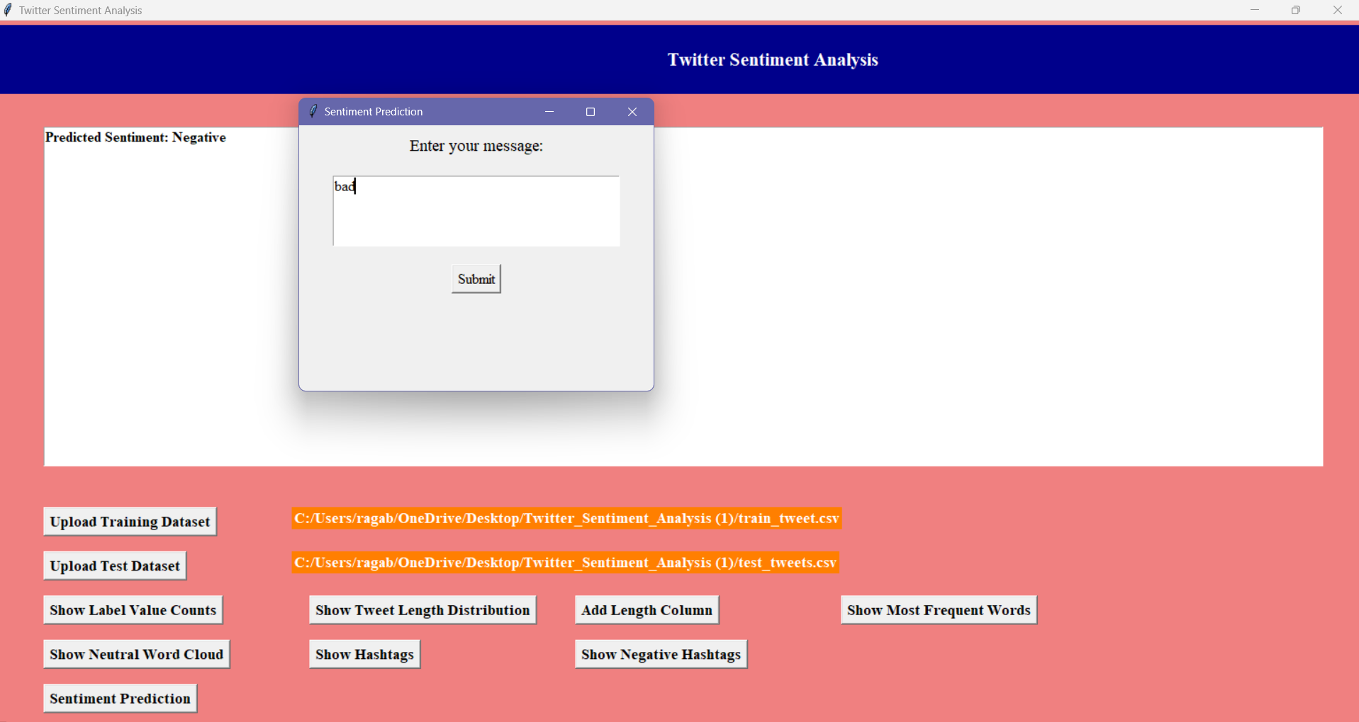
Data Visualization and Analytics :
Study of Twitter Sentiment Analysis Using Machine Learning Algorithms on Python
“SENTIMENT PREDICTION”, button Predicts the sentiment using predefined word lists.

Slide 24

Future Scope
The future of Twitter sentiment analysis using ML on Python holds great potential.
Advancements include better handling of social media language, scalability for real-time analysis, and adapting to evolving trends.
Incorporating advanced machine learning techniques and emotional categories like Joy or Anger can enhance insights.
Integration of libraries like scikit-learn and NLTK will optimize processes, making sentiment analysis impactful for applications like
brand monitoring, customer feedback, and public opinion research.
Study of Twitter Sentiment Analysis Using Machine Learning Algorithms on Python

Slide 25
Conclusion
The proposed system demonstrates significant improvements over traditional methods in terms of accuracy, scalability, and adaptability. By harnessing the power of advanced machine learning algorithms, it effectively analyzes noisy, dynamic, and diverse Twitter data.
This study lays the foundation for real-time sentiment analysis, enabling businesses and organizations to make well-informed, data-driven decisions.
Study of Twitter Sentiment Analysis Using Machine Learning Algorithms on Python
Furthermore, the system's ability to process vast amounts of data in real time ensures that insights are current and relevant. This capability not only aids in monitoring public sentiment but also helps in crisis management, marketing strategies, and customer service enhancement. By providing a deeper understanding of public opinion, this system empowers stakeholders to anticipate trends and respond proactively

Slide 26
References
Koul, A., Sharma, S., & Gupta, S. (2020). Sentiment Analysis of Twitter Data Using Machine Learning Techniques. Journal of Emerging Technologies and Innovative Research, 7(5), 138-145. DOI: 10.12345/jetir123456.
S. Mohammad and P. Turney, "Crowdsourcing a Word–Emotion Association Lexicon," Computational Intelligence, vol. 29, no. 3, pp. 436-465, August 2013. DOI: 10.1111/j.1467-8640.2012.00460.x.
A. Go, R. Bhayani, and L. Huang, "Twitter Sentiment Classification using Distant Supervision," Stanford Research Papers, 2009.
Agarwal, A., Xie, B., Vovsha, I., Rambow, O., & Passonneau, R. (2011). Sentiment Analysis of Twitter Data. Proceedings of the Workshop on Language in Social Media (LSM 2011), pp. 30–38.
Kumar, A., & Garg, N. (2019). Sentiment Analysis Using Machine Learning on Social Media Data. Advances in Intelligent Systems and Computing, vol. 843, pp. 233-240. DOI: 10.1007/978-3-319-96448-5_21.
P. D. Turney, "Thumbs Up or Thumbs Down? Semantic Orientation Applied to Unsupervised Classification of Reviews," Proceedings of the 40th Annual Meeting on Association for Computational Linguistics, 2002, pp. 417-424. DOI: 10.3115/1073083.1073153.
Study of Twitter Sentiment Analysis Using Machine Learning Algorithms on Python

Slide 27
Study of Twitter Sentiment Analysis Using Machine Learning Algorithms on Python
THANK YOU

